Slide 1
Flight Network Analysis
By Rajeev cs 789

Slide 2
Flight Network Analysis Report
Title Slide
Problem Statement
State of the Art & Motivation
Technical Challenges
Methodology: Our Approach
Results: Hub Analysis
Results: Community Detection
Results: Network Resilience
Results: Seasonal Patterns
Discussion & Insights

Slide 3
Problem Statement
Global Flight Network Structure: Investigate topology, node connectivity, and hierarchical organization governing global airport interactions.
Network Vulnerabilities and Features: Identify critical hubs, fragility points, and community clusters impacting route stability and disruption resilience.
Importance to Stakeholders: Inform airlines, planners, governments on strategic routing, infrastructure investment, and risk mitigation policies.
The dataset used in this project is from Openflights.org. it contains 6,072 airports connected by 67,633 flight routes.

Slide 4
State of the Art & Motivation
Scope of Prior Research: Existing studies target regional or airline-specific networks, lacking comprehensive global perspectives.
Post-Pandemic Analysis Gaps: COVID-19 exposed critical need for multi-layered analyses integrating temporal, spatial, and operational dimensions globally.
Full-Stack Data Motivation: Combining route, scheduling, and capacity data empowers strong and reliable network modeling.

Slide 5

Technical Challenges
Data Cleansing Complexity: Addressed incomplete and invalid IATA codes through rigorous validation and imputation techniques ensuring dataset integrity.
Large-Scale Graph Computation: Managed computational demands of 6000+ airports and 67000+ routes by optimizing graph representations and parallel processing.
Understanding about aviation.

Slide 6
Methodology
Data Acquisition & Graph Construction: Collected OpenFlights datasets; constructed directed graph with NetworkX; performed node and edge cleaning for accuracy.
Network Analysis Techniques: Computed degree, betweenness, and PageRank centralities; applied Louvain method on undirected graph for community detection.
Seasonal Modeling & Resilience Testing: Integrated regional and tourism coefficients for seasonality; simulated airport removals to assess network resilience dynamics.

Slide 7
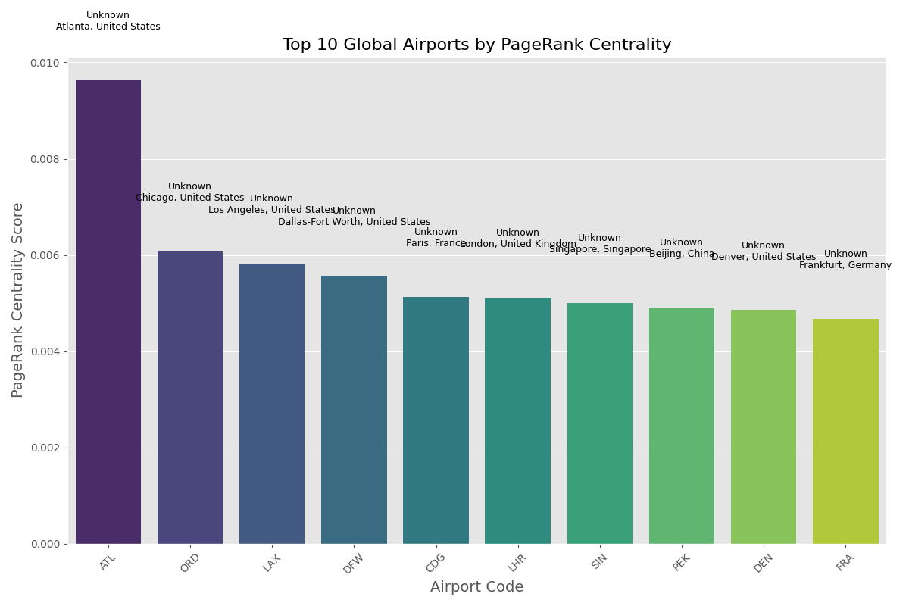
Results: Hub Analysis
Hub analysis identifies the most important airports in the network using centrality measures:
Degree Centrality: Counts the number of connections (routes) to/from an airport, identifying airports with many direct flights
Betweenness Centrality: Measures how often an airport acts as a bridge along the shortest path between other airports, identifying critical connecting hubs
PageRank: Evaluates importance by considering not just how many connections an airport has, but the importance of those connections

Slide 8
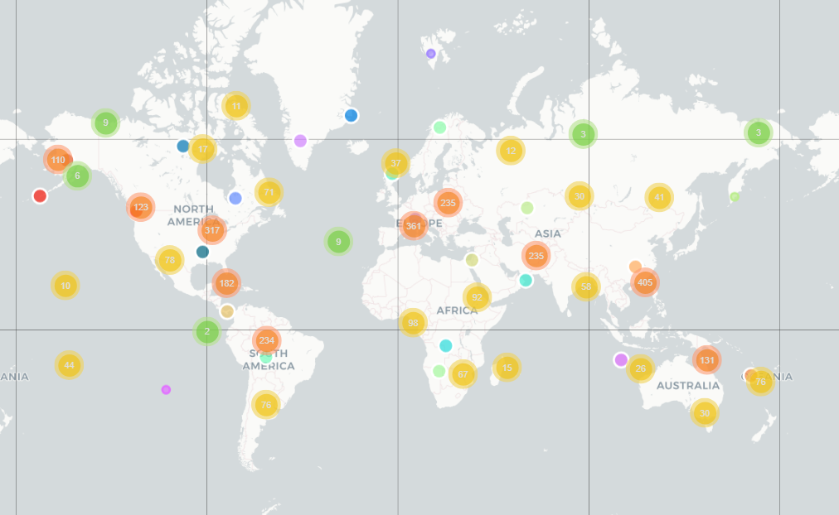
Results: Community Detection
Community detection finds groups of airports that are more densely connected to each other than to the rest of the network. The Louvain algorithm used in the code identifies communities by optimizing "modularity," which measures the strength of division into communities. The visualization shows how these communities often align with geographic regions or airline alliance networks.

Slide 9
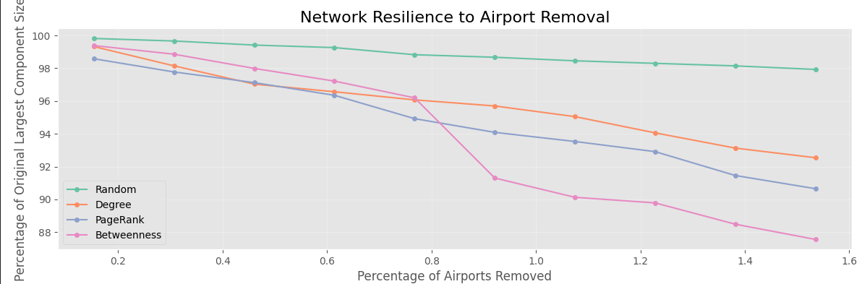
Results: Network Resilience
Resilience analysis tests how the network responds to disruptions through simulated airport removals. The code implements different removal strategies and measures how network connectivity degrades. The visualizations demonstrate that targeting high-centrality airports causes more rapid fragmentation than random removals. This reveals vulnerabilities in the network structure and helps identify critical airports whose failure would severely impact global connectivity.

Slide 10
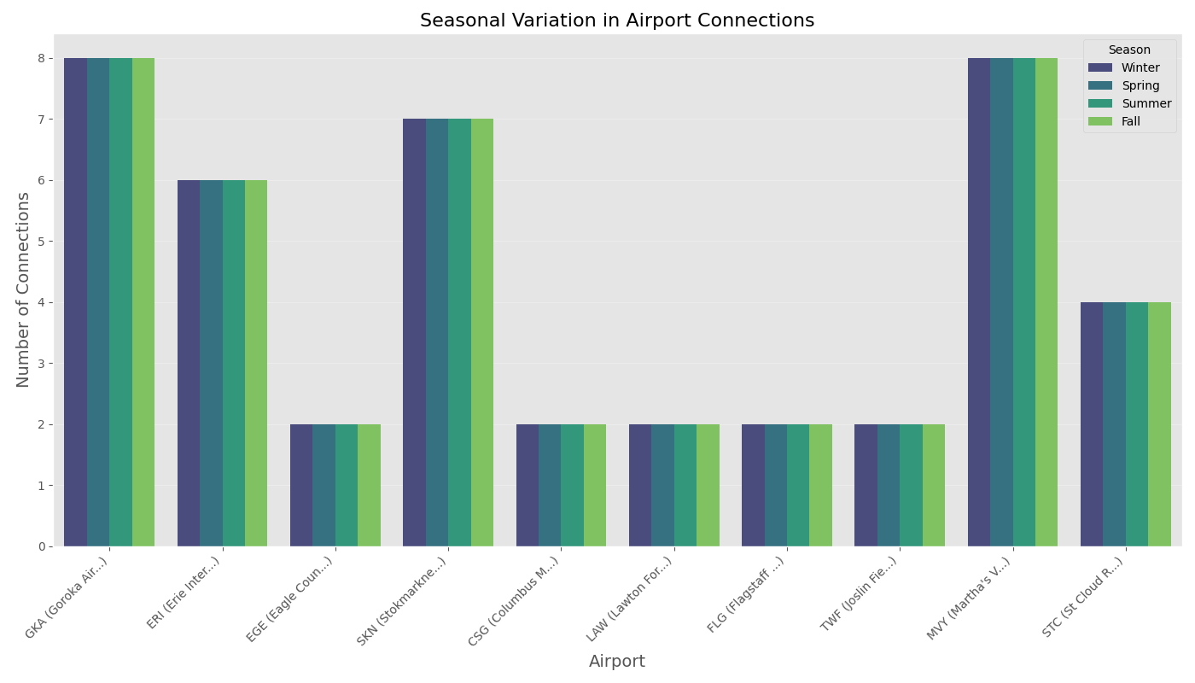
Results: Seasonal Patterns
Seasonal analysis examines how network structure changes across different seasons (winter, spring, summer, fall). Although dataset shows consistent metrics across seasons, the methodology allows for identifying airports with high seasonal variation in real-world applications. The visualizations would typically show how tourism patterns and weather conditions affect flight routes throughout the year.

Slide 11

Discussion & Insights
Geographic Communities: The network naturally divides into 24 distinct communities largely aligned with continental geography, with the five largest being North American, European, East Asian, Middle Eastern/South Asian, and South American.
Hub Structural Roles: Different hub types—traffic volume hubs or transfer hubs—drive network flow and resilience differently across regions.
Policy and Investment Implications: Tailored airline routing, strategic airport investments, and adaptive policies enhance network robustness and operational efficiency.

Slide 12
Future Work
Weighted Network Analysis: Integrate passenger volumes and real-time flight data to generate weighted graphs reflecting dynamic traffic flows.
Predictive Disruption Modeling: Develop machine learning models (GNN’S, GCN’S) forecasting flight disruptions to optimize contingency planning and network resilience.
Multimodal Transport Integration: Incorporate rail and sea networks to establish comprehensive multimodal mobility models enhancing intermodal connectivity.

Slide 13
Thank you

